Slide 1

Getting started with ESP8266
Module
Rohit Kumar

Slide 2
Contents
Title | Page
What is ESP8266
How to connect it with Arduino
Basic AT Commands

Slide 3
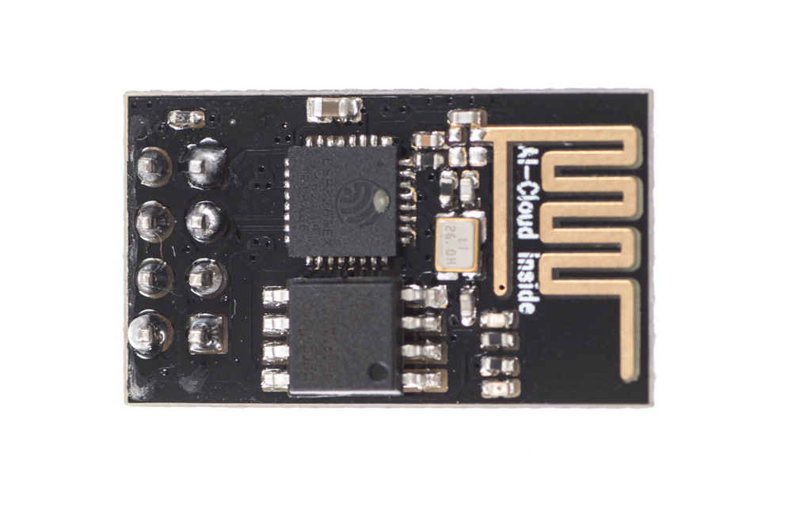
ESP8266 ESP-01
The ESP8266 ESP-01 is a Wi-Fi module that allows microcontrollers access to a Wi-Fi network. This module is a self-contained SOC (System On a Chip) that doesn’t necessarily need a microcontroller to manipulate inputs and outputs as you would normally do with an Arduino, for example, because the ESP-01 acts as a small computer. Depending on the version of the ESP8266, it is possible to have up to 9 GPIOs (General Purpose Input Output). Thus, we can give a microcontroller internet access like the Wi-Fi shield does to the Arduino, or we can simply program the ESP8266 to not only have access to a Wi-Fi network, but to act as a microcontroller as well.

Slide 4
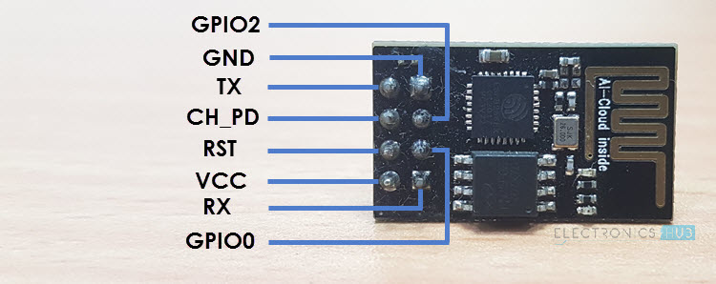
Pin description of ESP8266
VCC: It is the power pin through which 3.3V is supplied.
GND: It is the ground pin.
TX: This pin is used to transmit serial data to other devices.
RX: The RX pin is used to receive serial data from other devices.
RST: It is the Reset Pin and it is an active LOW Pin. (ESP8266 will reset if the RST pin receives LOW signal).
CH_PD: This is the chip enable pin and it is an active HIGH Pin. It is usually connected to 3.3V.
GPIO0: The GPIO0 (General Purpose I/O) Pin has dual functions – one for normal GPIO Operation and other for enabling the Programming Mode of ESP8266.
GPIO2: This is GPIO Pin

Slide 5
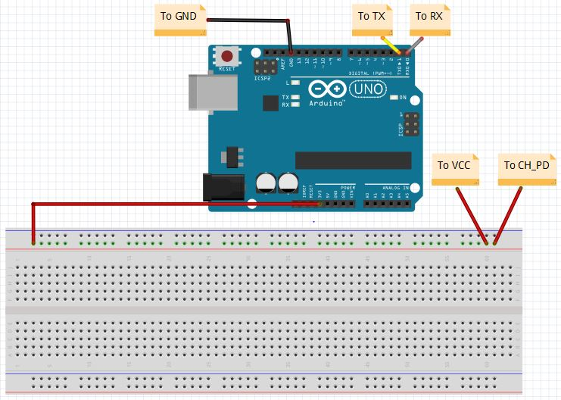
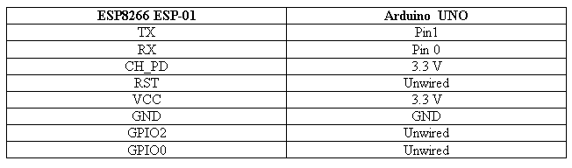
How to connect Esp8266 with Arduino Uno

Slide 6
Basic AT Commands
Upload the BareMinimum example to ensure that no previous programs are running and using the serial communication channel. Next, open the serial monitor and type the following command:
AT – This is to check whether your ESP8266 is working or not .
Response - You should get an “OK” response. This means that the module is working and that you are good to go. Now we are ready to test a two way communication between the module and another device.

Slide 7
The ESP8266 ESP-01 module has three operation modes:
Station (STA)
Access Point (AP)
Both
In STA mode, the ESP-01 can connect to an AP such as the Wi-Fi network from your house. This allows any device connected to that network to communicate with the module.

Slide 8
In AP the Wi-Fi module acts as a Wi-Fi network, or access point (hence the name), allowing other devices to connect to it. This does not mean that you will be able to check your Facebook from your device while the ESP-01 module is operating in the AP mode. It simply establishes a two way communication between the ESP8266 and the device that is connected to it via Wi-Fi.
The third mode of operation permits the module to act as both an AP and a STA.
AT+CWMODE= 1 → STA
AT+CWMODE=2 → AP
AT+CWMODE=3 → BOTH

Slide 9
If you want to check what mode your Wi-Fi module is in, you can simply type the following command:
AT+CWMODE?
This will display a number (1, 2, or 3) associated with the corresponding mode of operation.
AT+CWJAP= “Wi-Fi Network”,“Password” – This command connects esp8266 to your network. After a couple of seconds, you should get an "OK" response.

Slide 10
AT+CIFSR- This will display the station IP address of our ESP-01 module.
Now we need to enable multiple connections before we can configure the ESP8266 ESP-01 module as a server:
AT+CIPMUX=1
Once again, each number is associated with a type of connection:
Single = 0
Multiple = 1

Slide 11
AT+CIPSERVER=1,80 :- This is used to start the server at port 80.
The first number is used to indicate whether we want to close server mode (0), or open server mode (1).
The second number indicates the port that the client uses to connect to a server.
We chose port 80 because this is the default port for HTTP protocol.

Slide 12
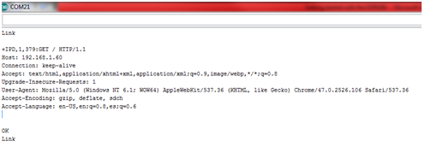
ESP8266 ESP-01
Now open your browser and type the IP address of your ESP module. You will get this response.
This image contains the HTTP request that our computer sends to the server to fetch a file. It contains some interesting information such as what file you want to retrieve, name of the browser and version, what operating system you are using, what language you prefer to receive the file in, and more.

Slide 13
AT+CIPSEND=0,5 :- This command is used to send some data and display it in our web browser’s window.
The “0” indicates the channel through which the data is going to be transferred; while “5” represents the number of characters that are going to be sent. When we hit enter, the symbol “>” appears. This indicates that we can now type the characters that we want to send to the browser. In this example we chose “hello.” After a couple of seconds we get the response "SEND OK." This means that the data has been transmitted successfully to the client. However, nothing appears on the web browser’s window yet. This is because it is required to close the channel first in order to display the characters.

Slide 14

AT+CIPCLOSE=0 : This command is used to close the channel. “0” indicates the channel that is being closed. Once we hit enter, our message is displayed on the web browser’s window:

Slide 15
Thank You !
Contact US
Nitin Sinha
nitin.sinha@goSigmaWay.com
+1 727-394-4375
+91 7838188809
Debjani Mitra
debjani.mitra@goSigmaWay.com
+1 952-583-3449
+91 9339555636
Rohit Kumar
rohit.kumar@sigmaway.us
+91 7982577830
+91 7838021754

